Slide 1
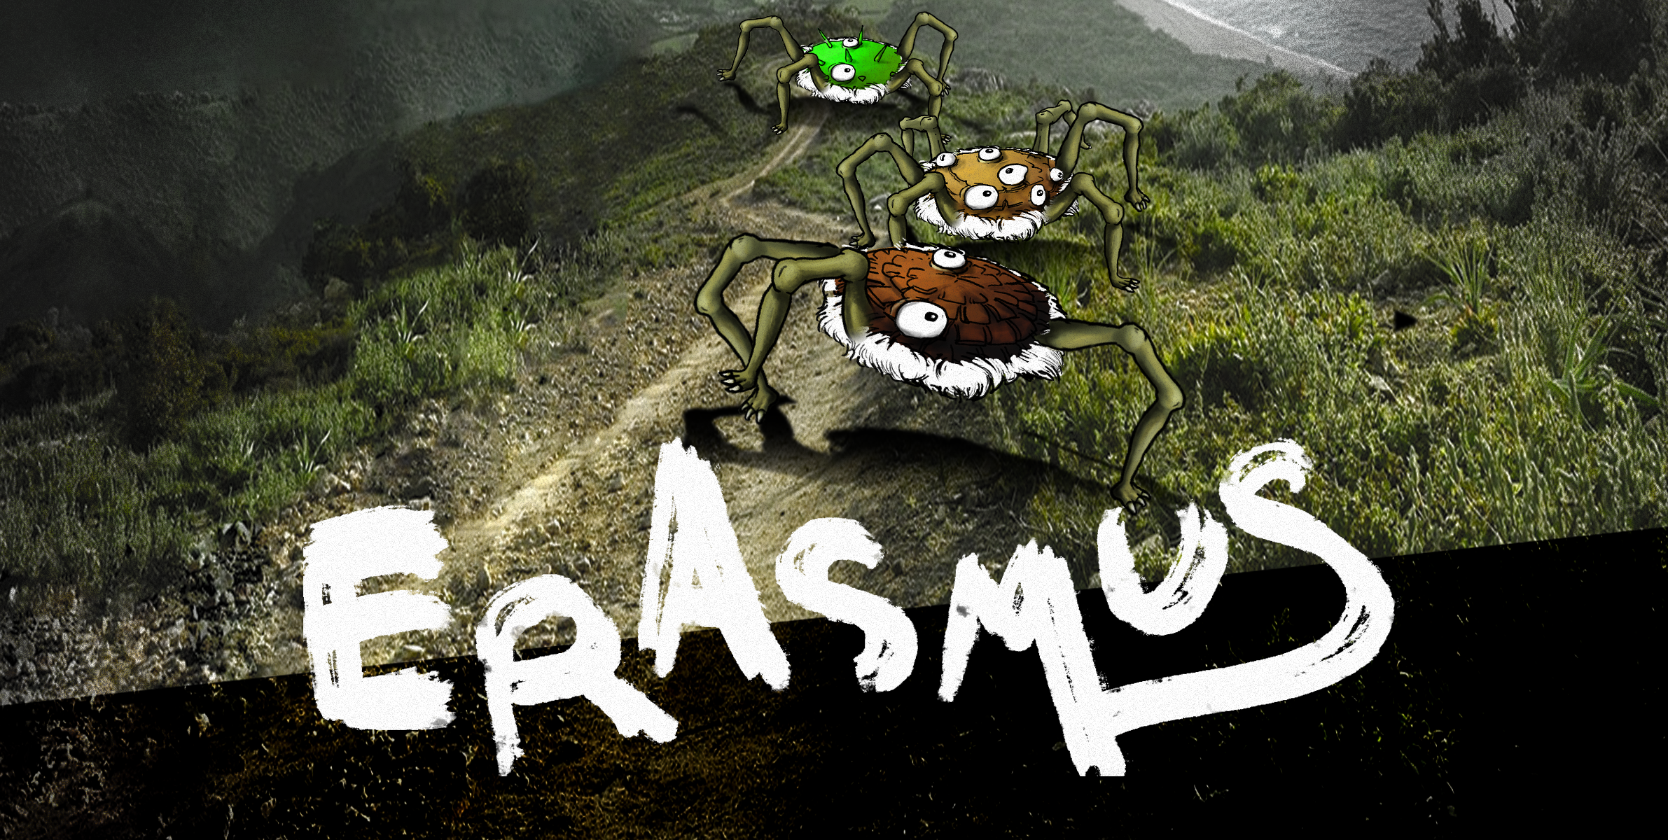
2D Top Down Evolution Game / Noam Bloom & Yoel Simhovitch

Slide 2
Outline
Theme
Game Design
Demo
Architecture
Graphic representation
Challenges
Future Thoughts
Short Term
Long Term

Slide 3


Slide 4
Theme
A ludicrous space race called the “Shmondralites” grew tired of being meager and weak, so they decided to send three representatives to each of the nearest dangerous planets in their galaxy in hope to let evolution do what it does and become an awesome race again!

Slide 5
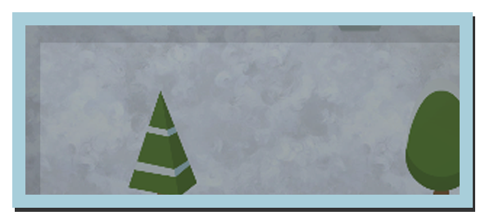
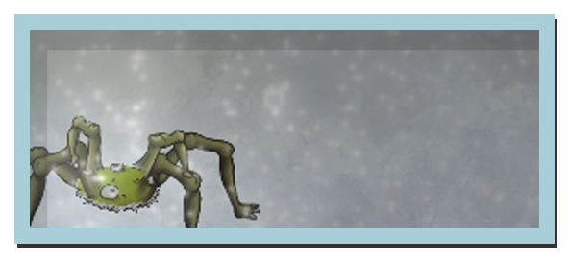
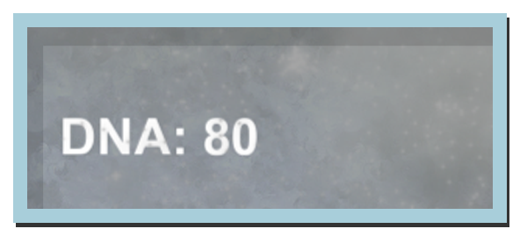
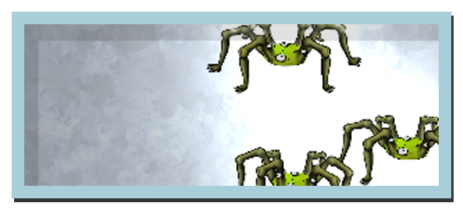
Theme (continued)
Erasmus is a 2D, Top-Down, Highscore, evolution minigame.
Where you control a herd of creatures, which must survive and evolve for as long as possible.

Slide 6


Slide 7

Game Design
The Erasmus game-world is challenging and constantly changing.
To survive, the herd must eat and evolve,
So the player needs to constantly:
Lead the herd to food (nudging them with mouse drags).
Evolve the herd to face the changing world conditions.
Evolving is done by either Splitting or Mating.

Slide 8
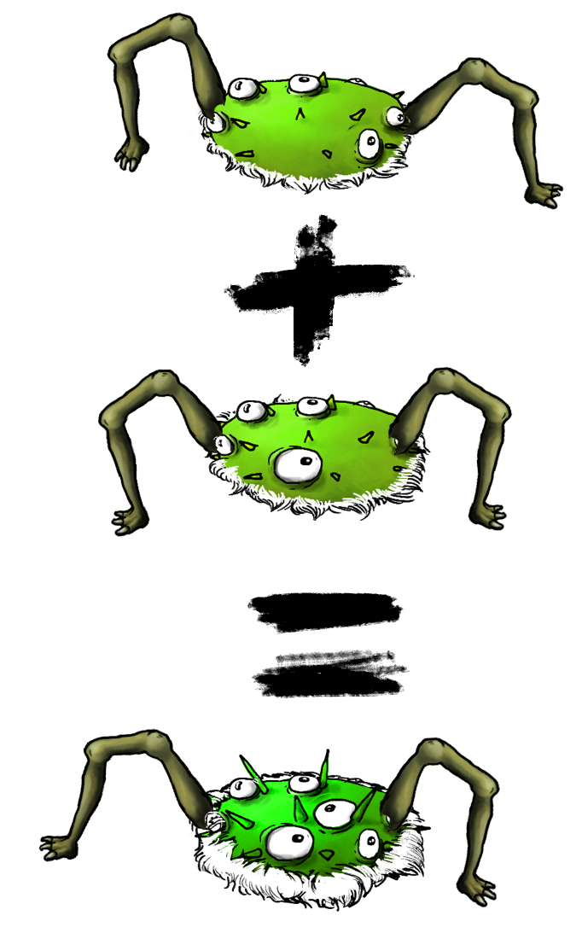
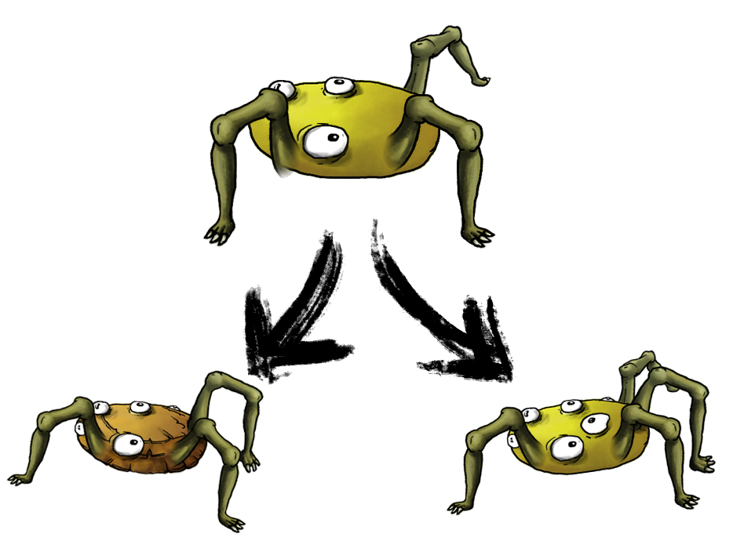
Game Design (continued)
Split: Introduces mutation.
Mate: Selective breeding.

Slide 9
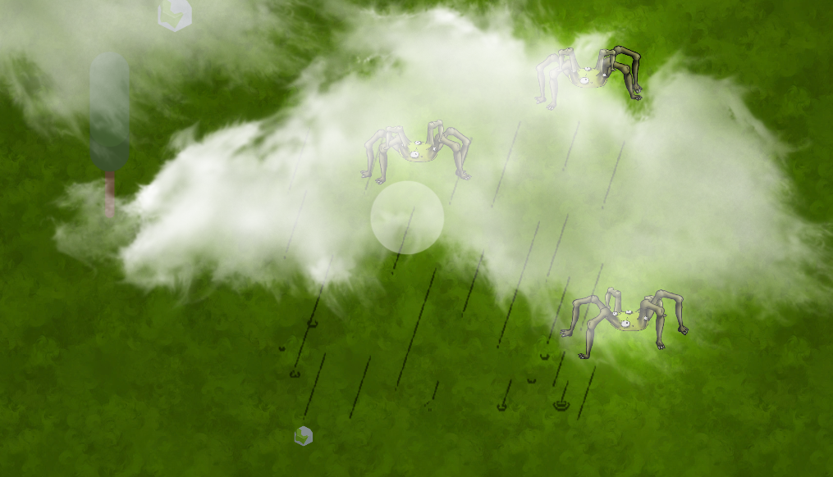
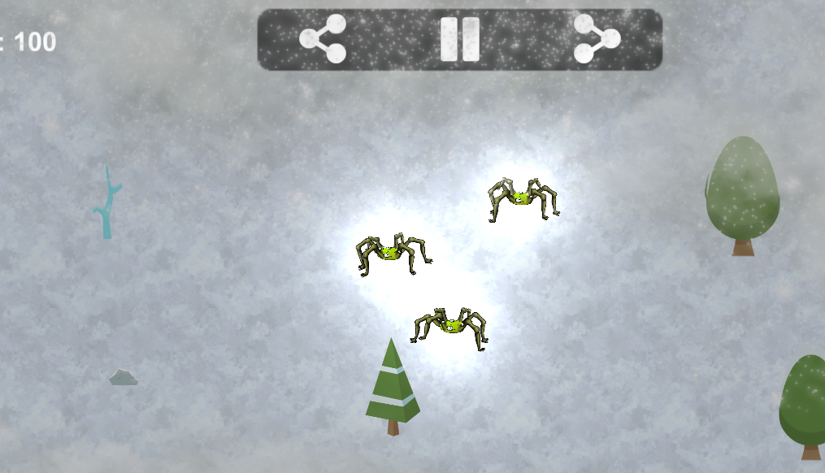
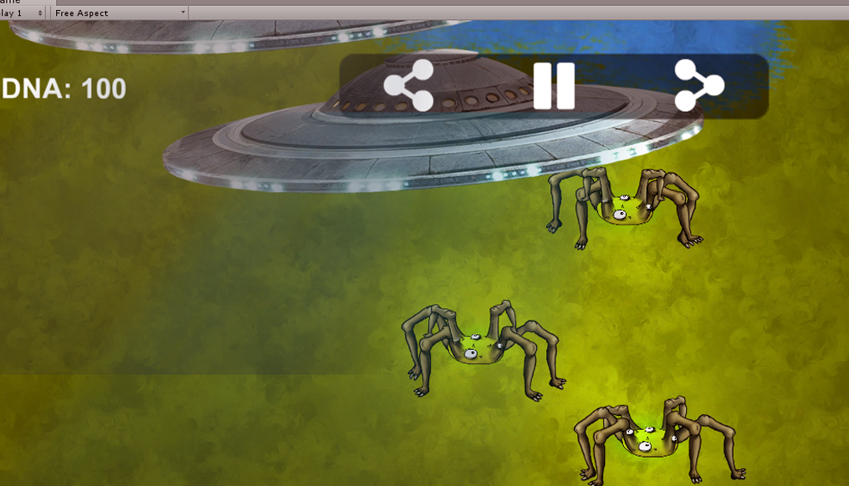
Game Design (continued)
By evolving your herd, you can strengthen qualities that protect you from the current danger.
Example: Split & Mate your hairiest creatures to create a furry herd that is immune to the cold.

Slide 10
Game Design (continued)
DNA as currency
The user cannot always split & mate.
The Split / Mate actions cost “DNA”.
“DNA” is earned by winning achievements (e.g. first 10 splits), and when creatures dies of old age in good health. The player is penalized otherwise.

Slide 11
Game Design (continued)
Win / lose condition
Win condition: Reach the highest score you can.
Lose condition: All creatures are dead.

Slide 12


Slide 13


Slide 14
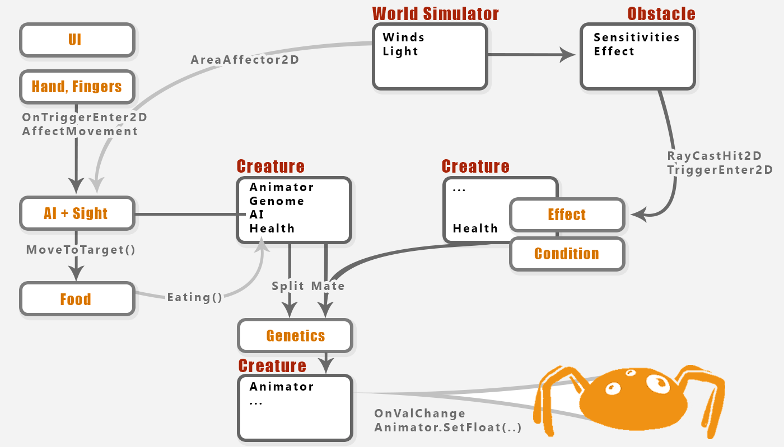

Slide 15
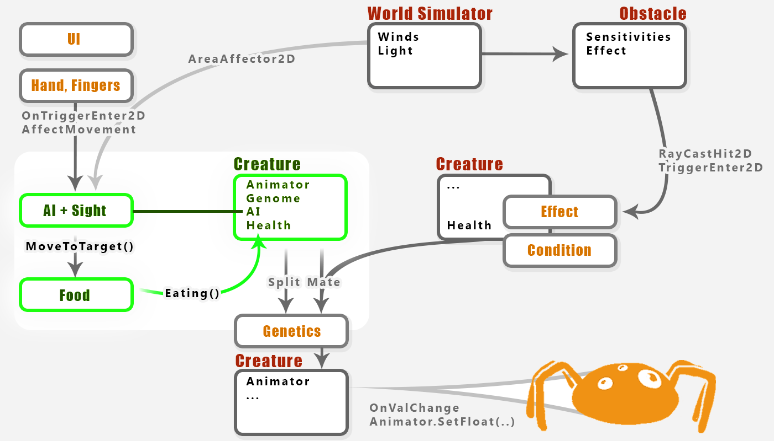
Each creature has:
Health (decreases with time, dies when 0)
Age (increases with time, dies eventually)
DNA (Genome) defining it’s appearance & abilities,
Basic AI: decide where to move based on:
Sight mechanism
Desire to eat
Fear of obstacles
Stay with herd (center of mass)

Slide 16
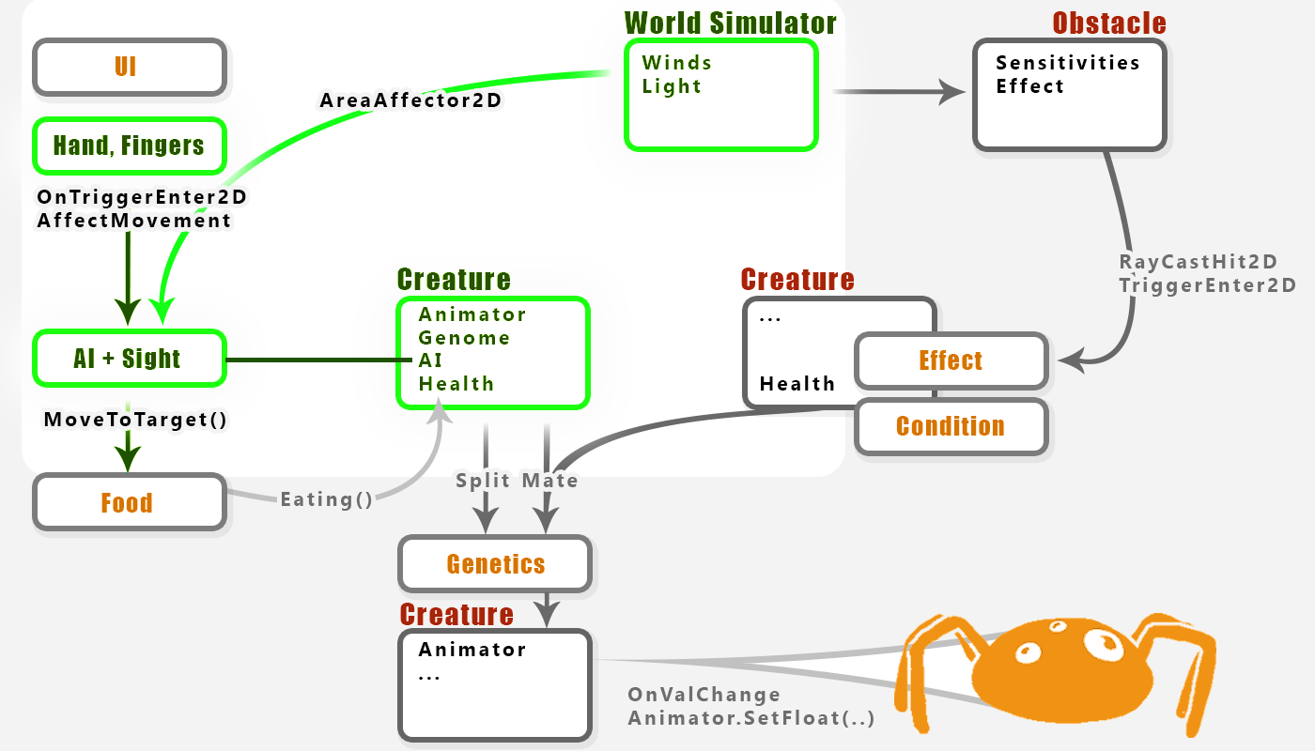
Creature movement is determined by:
AI as specified before (sight, desires).
Wind
User input (mouse drags / finger swipes)
The creature creates a weighted decision of the player’s input with his own, where player actions are weighed 100% when performed and decay shortly after.

Slide 17
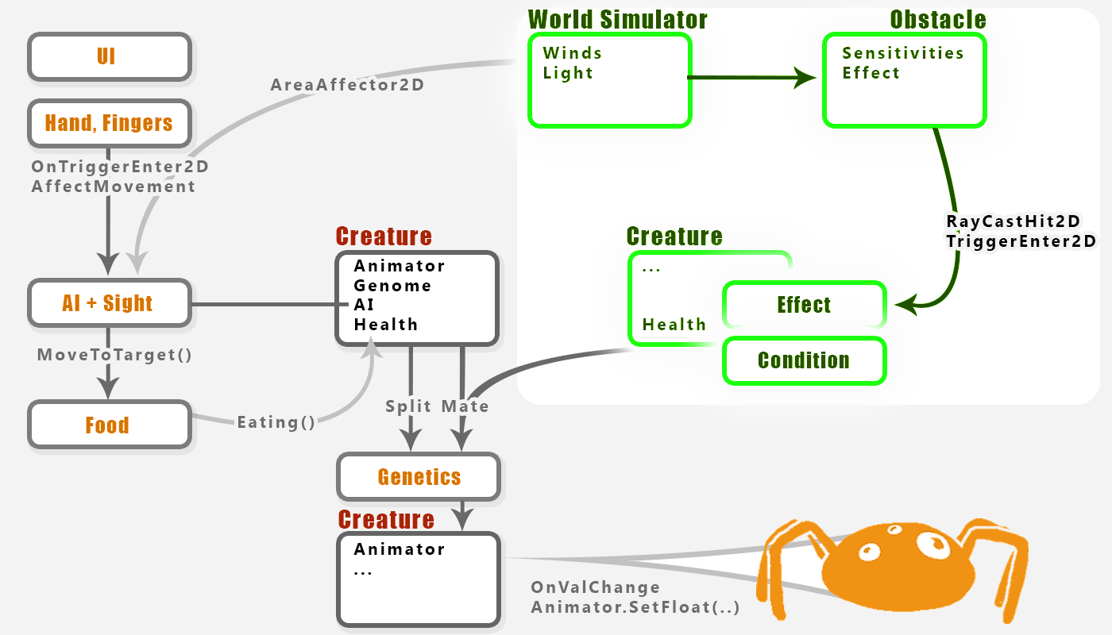
The WorldSimulator spawns obstacles which make the world dynamic and everchanging.
Obstacles can be either Floaters or Stationaries.
Floaters cast rays to affect creatures, Stationaries use triggers.
When hit, creatures are attached with an “Effect” component which damages them and is later deactivated. This enables effects to keep working even when the creature has left the dangerous area, thus simulating poison / burn / etc.

Slide 18
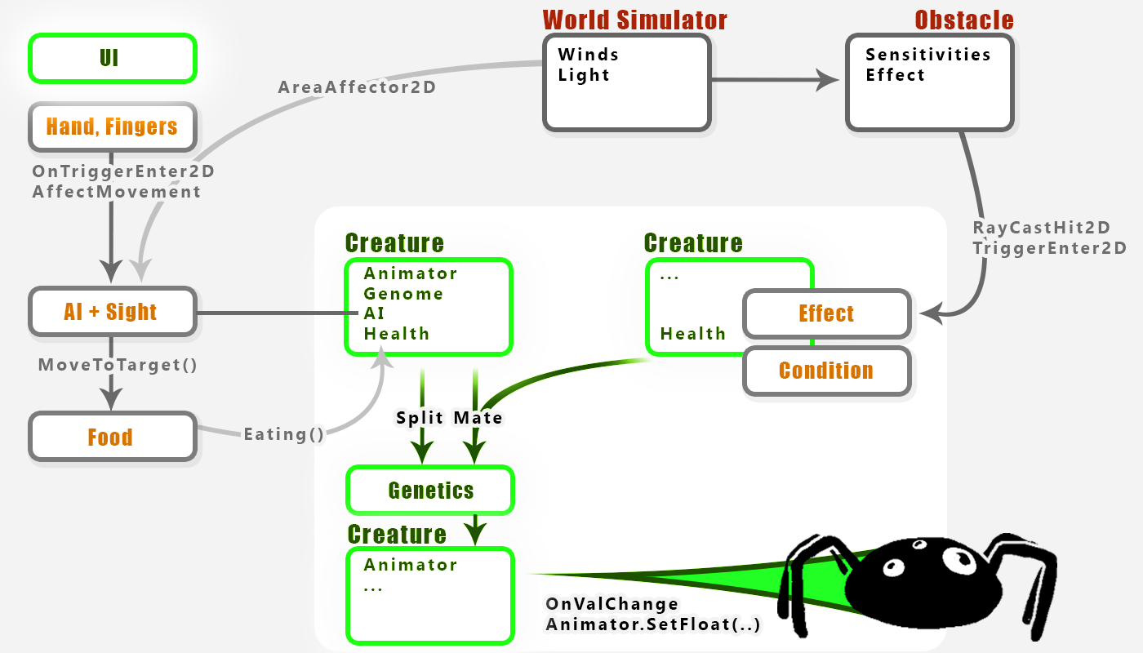
Using the UI, the player can Split one creature into 2, or mate 2 creatures.
Splitting & mating spawn a new creature (using an object pool), whose Genome is determined by it’s parent/s, but is brought to extreme and might undergo mutation.
Whenever a Gene in the creature’s Genome changes it’s value, it affects the creature’s appearance (through animator parameters) and some properties.

Slide 20


Slide 21
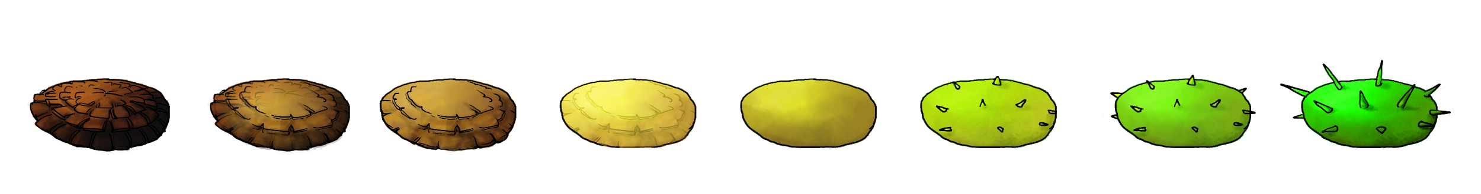
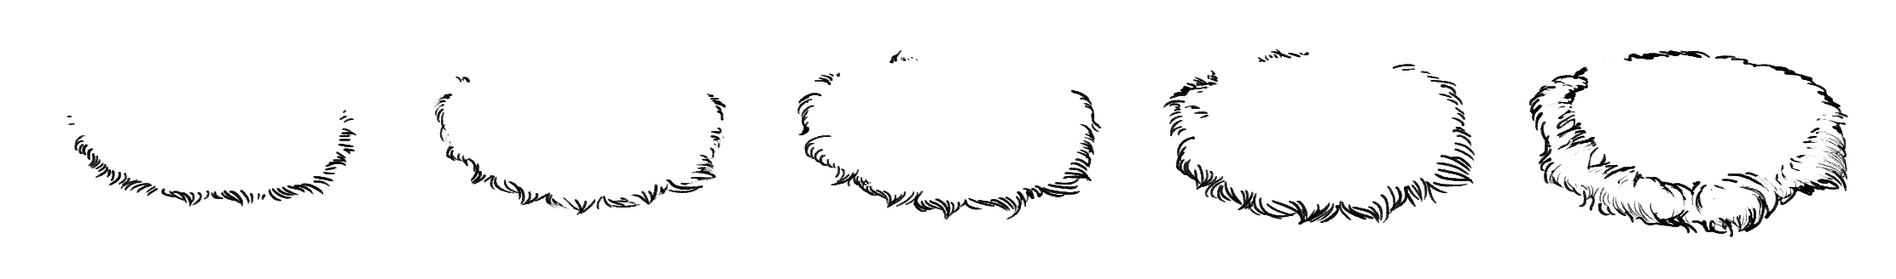

Graphic representation
We designed the creatures’ graphics to be modular. They can have many (many) variations.

Slide 22
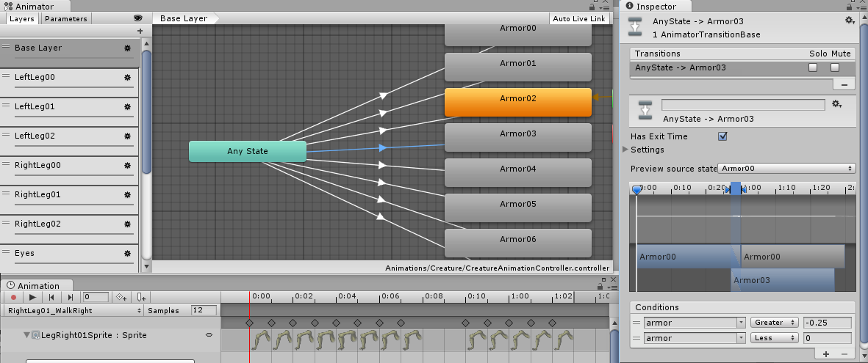
Graphic representation (continued)
We used Unity’s Animator layers system to control each creature part seperately.

Slide 23


Slide 24
Challenges
Simulating a world.
Make graphics represent current creature state
Genetics algorithm
UI - controlling a herd: many possible mechanisms.
Mobile Platform Design

Slide 25


Slide 26
Future Thoughts
Short term
More Genes: Flight, Obedience
More Properties: Hunger, Illness, On Fire, Wet, Cold
Continuous Graphic Representation of Genes
Challenges: Breed for x seconds to let your survive nuclear winter on its own.
Long term
Multiplayer
Random qualities
Enemies / other races

Slide 27


